Slide 1
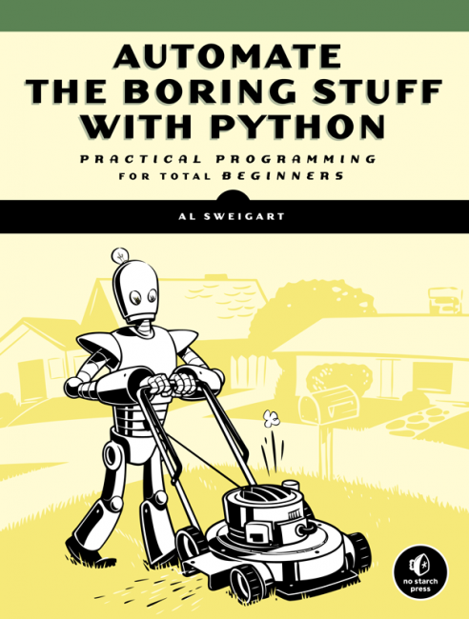
Yes, it’s time to learn regular expressions.
@AlSweigart
(last name rhymes with “why dirt”)
bit.ly/yesregex

Slide 2
“In general, I can do regular expressions but they’re a pain in the as

Slide 3
Yes, it’s time to learn regular expressions.
aka “regex”

Slide 4
415-730-0000
4,157,300,000

Slide 6
The Three Lines of Code You Need
import re
myRegex = re.compile('regex pattern')
mo = myRegex.search('haystack string')
print(mo.group())

Slide 7
The Four Lines of Code You Need
import re
myRegex = re.compile('regex pattern')
mo = myRegex.search('haystack string')
print(mo.group())

Slide 8
The Four Lines of Code You Need
import re
myRegex = re.compile('regex pattern')
mo = myRegex.search('haystack string')
print(mo.group())
bit.ly/yesregex

Slide 9
myRegex = re.compile('regex pattern')

Slide 11
Digit
Digit
Dash
Digit
Digit
415-730-0000
Digit
Digit
Digit
Digit
Dash
Digit
Digit

Slide 12
Making the Regex String
phoneRegex = re.compile(
''
)

Slide 13
Making the Regex String
phoneRegex = re.compile(
'\d'
)

Slide 14
Making the Regex String
phoneRegex = re.compile(
r'\d'
)

Slide 15
Making the Regex String
phoneRegex = re.compile(
'\\d'
)

Slide 16
Making the Regex String
phoneRegex = re.compile(
r'\d'
)

Slide 17
Making the Regex String
phoneRegex = re.compile(
r'\d\d\d'
)

Slide 18
Making the Regex String
phoneRegex = re.compile(
r'\d\d\d-'
)

Slide 19
Making the Regex String
phoneRegex = re.compile(
r'\d\d\d-\d\d\d-\d\d\d\d'
)

Slide 20
Making the Regex String
>>> mo = phoneRegex.search("""Alice,
My number is 415-730-0000.
Call me when it's convenient.
-Bob""")

Slide 21
Making the Regex String
>>> mo = phoneRegex.search("""Alice,
My number is 415-730-0000.
Call me when it's convenient.
-Bob""")
>>> if mo is not None:
... print(mo.group())

Slide 22
Making the Regex String
>>> mo = phoneRegex.search("""Alice,
My number is 415-730-0000.
Call me when it's convenient.
-Bob""")
>>> if mo is not None:
... print(mo.group())
415-730-0000

Slide 23
Making the Regex String
>>> mo = phoneRegex.search("""Alice,
My number is 415-730-0000.
Call me when it's convenient.
-Bob""")
>>> if mo is not None:
... print(mo.group())
415-730-0000

Slide 24
def isPhoneNumber(text):
if len(text) != 12:
return False
for i in range(0, 3): # check area code
if not text[i].isdecimal():
return False
if text[3] != '-':
return False
for i in range(4, 7): # check first 3 digits
if not text[i].isdecimal():
return False
if text[7] != '-':
return False
for i in range(8, 12): # check last 4 digits
if not text[i].isdecimal():
return False
return True
text = """Alice,
My number is 415-730-0000.
Call me when it's convenient.
-Bob"""
for i, _ in enumerate(text):
if isPhoneNumber(text[i:i+12]):
print(text[i:i+12])

Slide 25
Character Class
\d Digit characters (numbers)
\w Word characters (letters & numbers)
\s Space characters (space, tab, \n)
\D Non-digit
\W Non-word
\S Non-space

Slide 26
Create Character Classes
Put characters inside []
[aeiouAEIOU] Matches vowels
[^aeiouAEIOU] Matches non-vowels
[0-9a-zA-Z] Same as \w

Slide 27
Punctuation = Escape
.
*
^
( )
$
\
|
?
{ }
[ ]
+

Slide 28
Punctuation = Escape
\.
\*
\^
\( \)
\$
\\
\|
\?
\{ \}
\[ \]
\+

Slide 29
Create Character Classes
Put characters inside []
[aeiouAEIOU] Matches vowels
[^ aeiouAEIOU] Matches non-vowels
[0-9a-zA-Z] Same as \w
[\(\)] Matches ( or )

Slide 30
Specifying Quantity
415-730-0000
\d\d\d-\d\d\d-\d\d\d\d

Slide 31
Specifying Quantity
415-730-0000
\d{3}-\d{3}-\d{4}
After: Quantity
Before: Pattern

Slide 32
Specifying Quantity
\d One digit
\d? Zero or one digits
\d* Zero or more digits
\d+ One or more digits
\d{3} Exactly 3 digits
\d{3,5} Btwn 3 and 5 digits
\d{3,} 3 or more digits

Slide 33
Specifying Quantity
\s One space
\s? Zero or one space
\s* Zero or more space
\s+ One or more space
\s{3} Exactly 3 space
\s{3,5} Btwn 3 and 5 space
\s{3,} 3 or more space

Slide 34
Specifying Quantity
[aeiou] One vowel
[aeiou]? Zero or one vowels
[aeiou]* Zero or more vowels
[aeiou]+ One or more vowels
[aeiou]{3} Exactly 3 vowels
[aeiou]{3,5} Btwn 3 and 5 vowels
[aeiou]{3,} 3 or more vowels

Slide 35
Grouping
FYI if you don’t speak Japanese:
Japanese letters are usually consonant-vowel combinations.
'sayonara' = sa ● yo ● na ● ra
[^aeiou][aeiou]+
After: Quantity
Before: Pattern
Just one of this pattern

Slide 36
Grouping
[^aeiou][aeiou]+
saaaaaaaaaaaaaa
saoiaeueaoieuaio
([^aeiou][aeiou])+
sasasasasasasasa
sayonara

Slide 37
1,234,567,890 Example
A regex for comma-formatted numbers:
e.g. 1,234,567,890
“One to three digits, followed by zero or more groups of comma-digit-digit-digit.”
Regex Buddy / Regex Tester
http://pyregex.com/
http://regexr.com/

Slide 38
Alternatives with Pipe
egg_and_spam_
egg_bacon_and_spam_
egg_bacon_sausage_and_spam_
spam_egg_spam_spam_bacon_and_spam_
re.compile(
r'(egg_)+(bacon_)+(sausage_)+(and_)+(spam_)+'
)

Slide 39
Alternatives with Pipe
Like [aeiou] but for words.
egg_ OR bacon_ OR sausage_ OR and_ OR spam_
Use the | pipe to have alternative groups:
re.compile(
r'((egg_)|(bacon_)|(sausage_)|(and_)|(spam_))+'
)
spam_ spam_ spam_ spam_ spam_ spam_ spam_ spam_ spam_ spam_ spam_ spam_ spam_ spam_ spam_ spam_ spam_ spam_ spam_ spam_ spam_ spam_ spam_ spam_ spam_ spam_ spam_ spam_ spam_ spam_ spam_ spam_

Slide 40
Match Anything
The . means “any character except newline”
The * means “zero or more”
.* means “match whatever”
.*? means “match the least of whatever”

Slide 41
Match Anything
'Looking for text <in between angle brackets>'
re.compile(r'<.*?>')
'<TO SERVE HUMANS>'
re.compile(r'<.*>')
'<TO SERVE HUMANS> FOR DINNER>'
DUN DUN DUUUHN!!!

Slide 42
What Regexes Can’t / Shouldn’t Do
DON’T PARSE HTML WITH REGEX.
A regex for strong passwords.
Includes lowercase, uppercase, numbers, special character, at least 12 characters.
(Just use multiple regexes.)
(Match(ing) ((nested) (parentheses.)))
(Regexes don’t have variables or flow control!)
“A regex to match regex strings.”

Slide 43
Yes, it’s time to learn regular expressions.
@AlSweigart
(last name rhymes with “why dirt”)
bit.ly/yesregex

